Slide 1
Animation 1
Smith et al., 2022

Slide 2
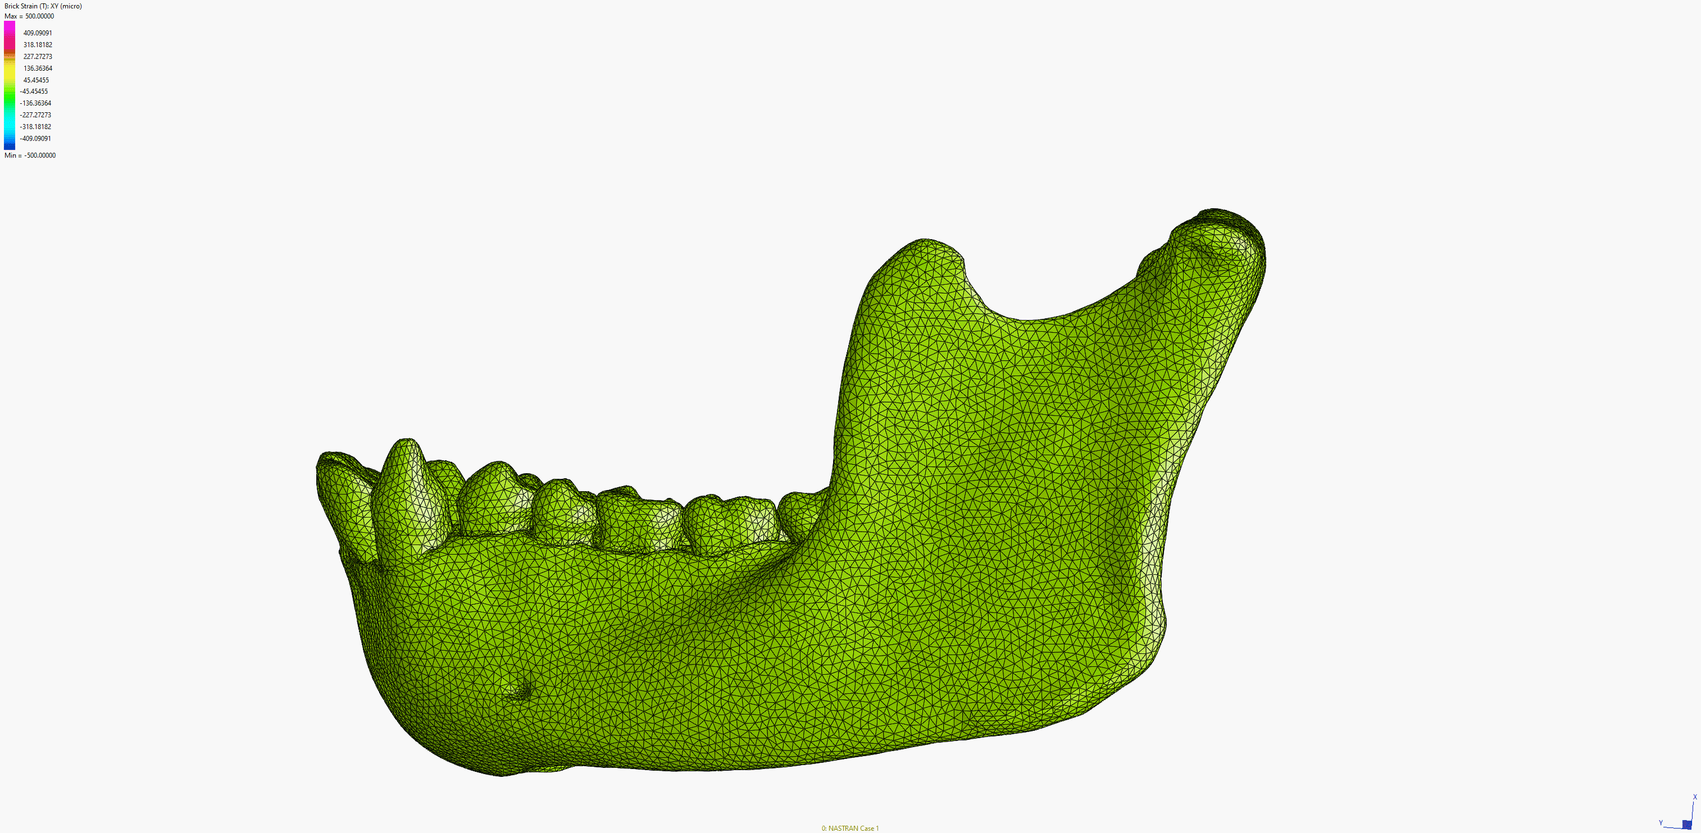
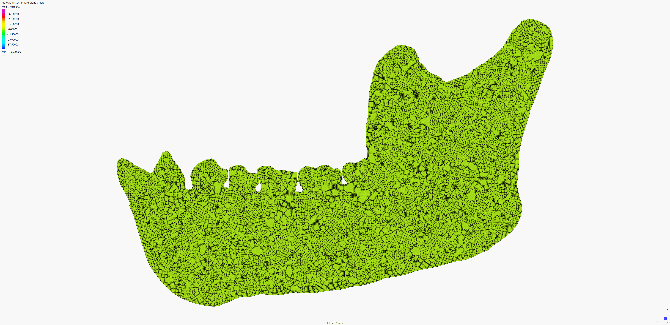
Deformation of 3D and 2D models
3D model from Smith et al., 2021
2D model from this study

