Slide 1
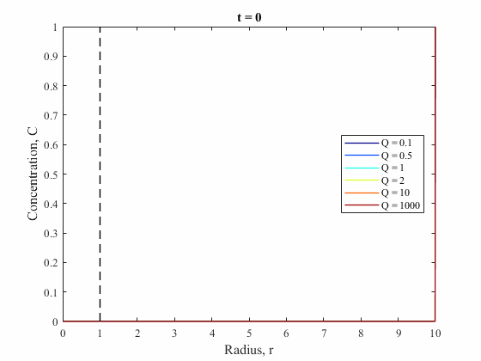
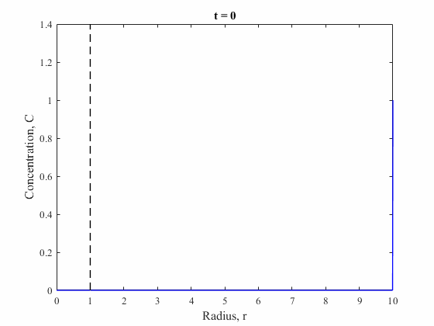
FIGURE 1 (animations)

Slide 2
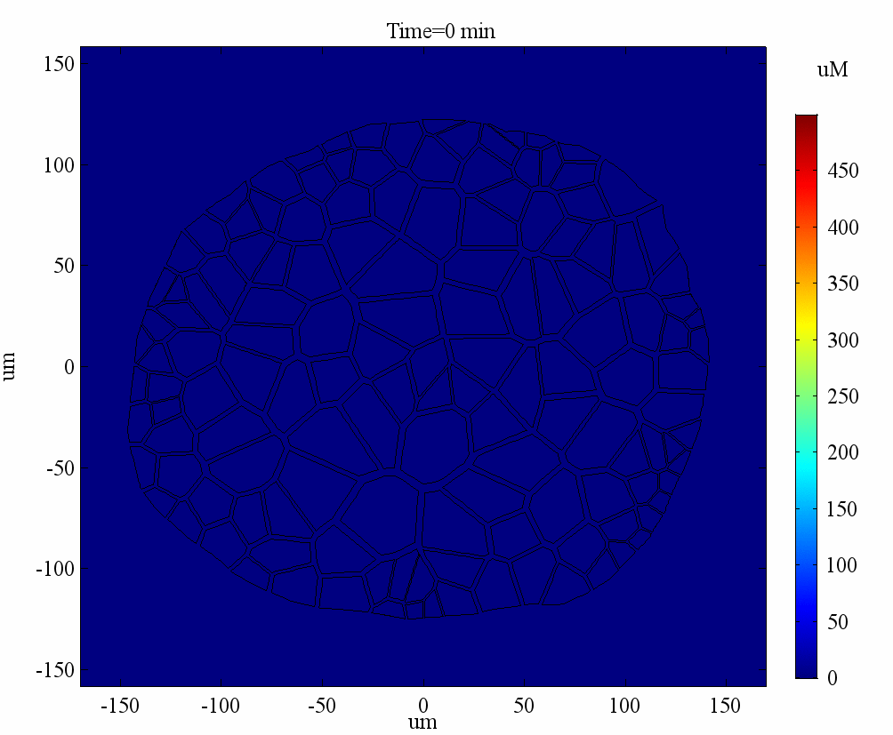
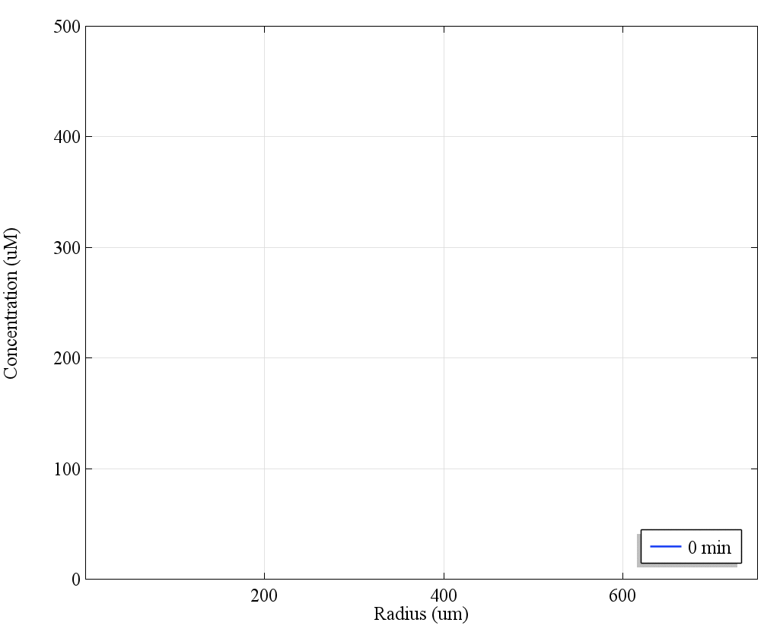
FIGURE 3 (animations)
LogD_{7.4} = 5

Slide 3
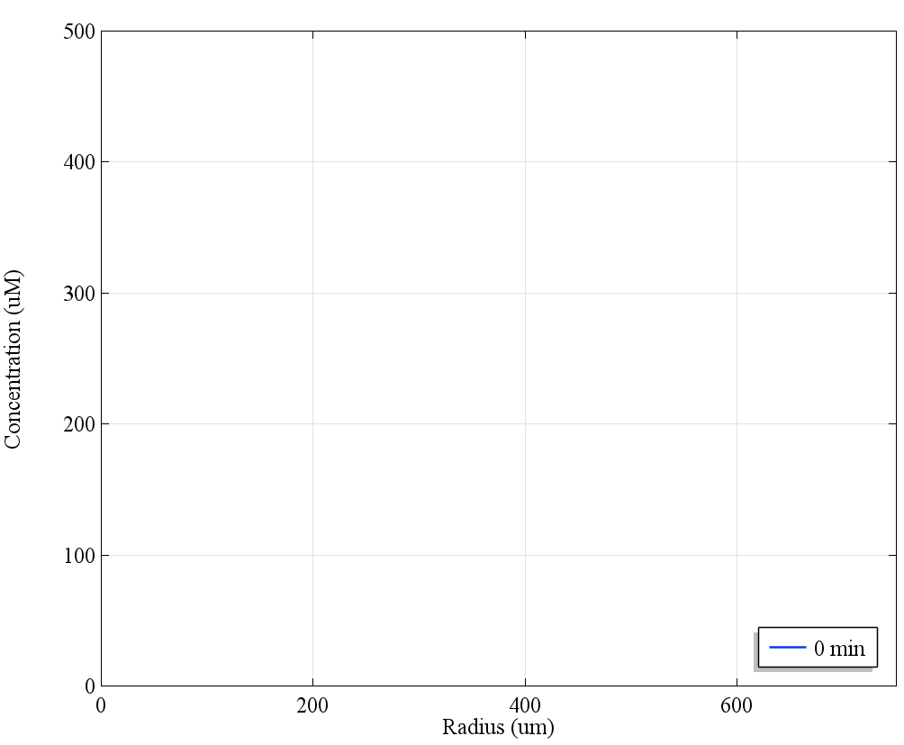
FIGURE 3 (animations)
LogD_{7.4} = 3

Slide 4
FIGURE 3 (animations)
LogD_{7.4} = 1

