Slide 1
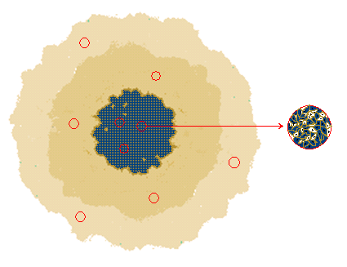
A
B
p
center of
symmetry
d
d
n
n
n
n
p
d
p
dormant
proliferating
necrotic
imaging
sensing

Slide 2
C
500 μm

