Slide 1
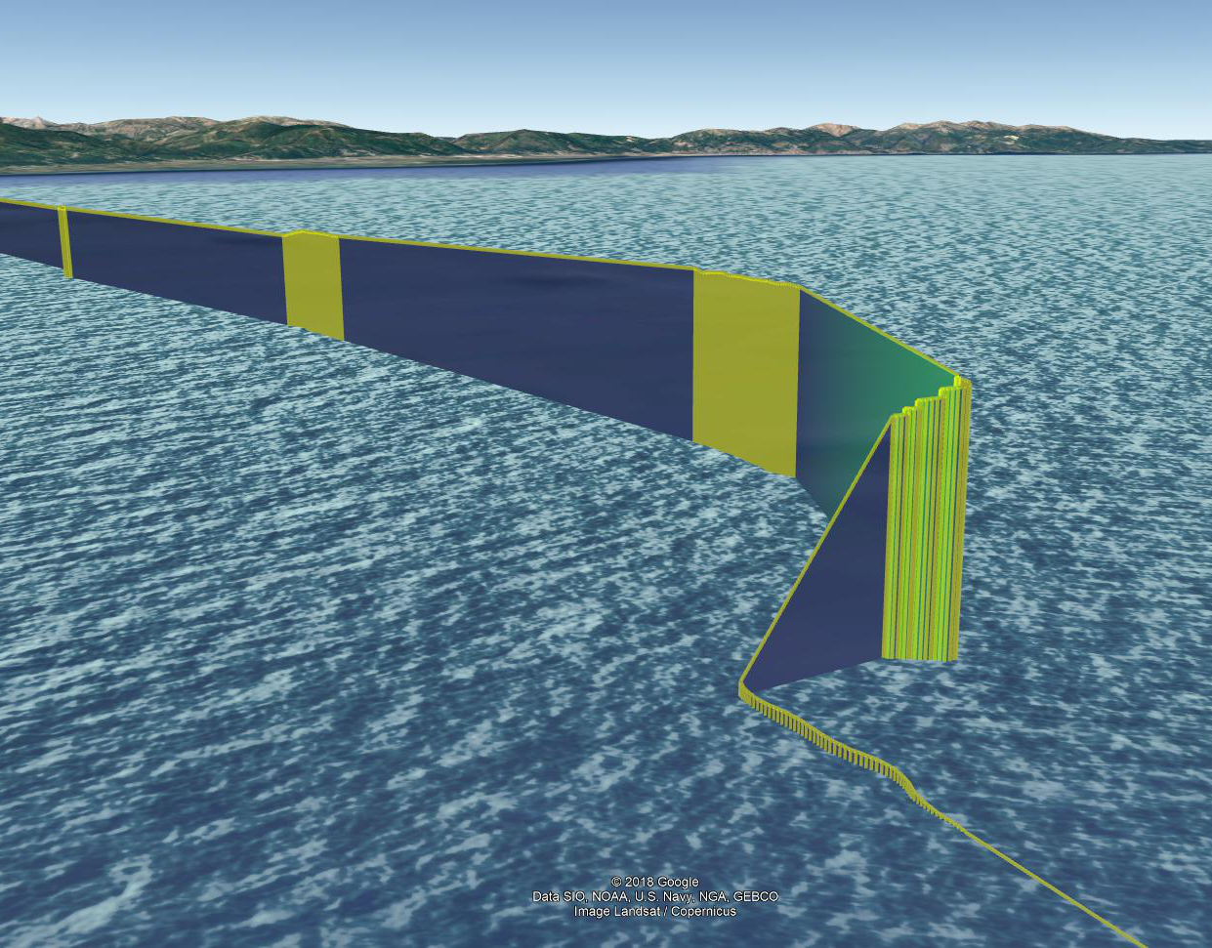
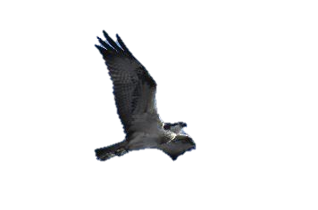
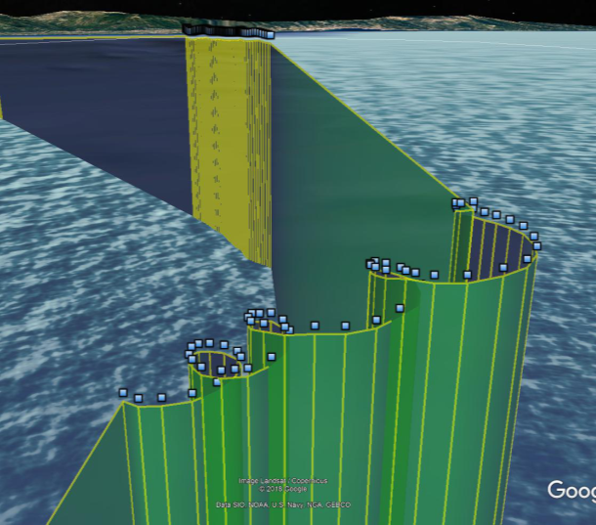
Burst 3: glide
698 m asl
Corsica island: 35 km distance
Montecristo island: 28 km distance
12:02:44
12:03:44
Burst 2: soar-glide
703 m asl
11:56:33
Burst 1: flap
2 m asl
11:57:33
11:50:22
11:51:22

